Slide 1
Nervous System
Spinal nerves Nursing Catalyst
https://www.nursescatalyst.com/

Slide 2
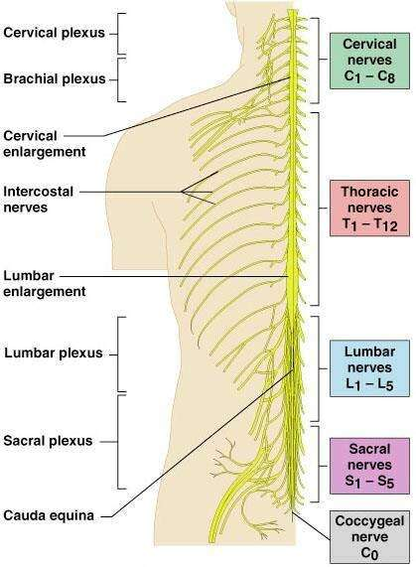
Introduction to Nerve Plexuses
Nerve plexus – a network of nerves
Ventral rami (except T₂ – T₁₂)
Branch and join with one another
Form nerve plexuses
Cervical
Brachial
Lumbar
Sacral
Primarily serve the limbs
Fibers from ventral rami crisscross

Slide 3
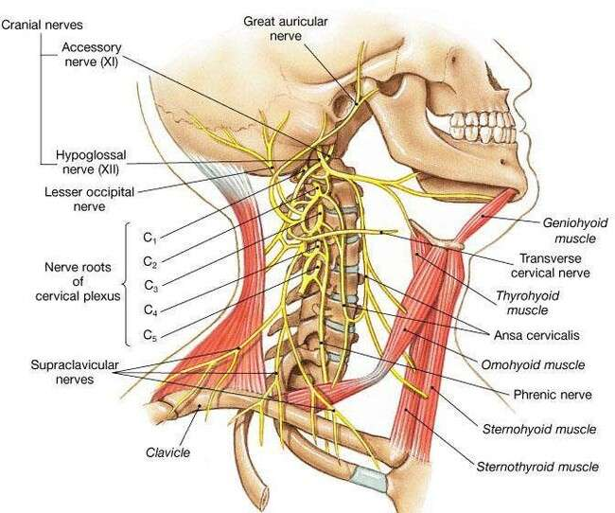
The Cervical Plexus
Cervical plexus- formed from anterior rami of 1st 4 cervical nerves
🞄 Supplies skin of much of the head and neck
🞄 Gives rise to the phrenic nerve (C3-C4) which innervates the diaphragm

Slide 4
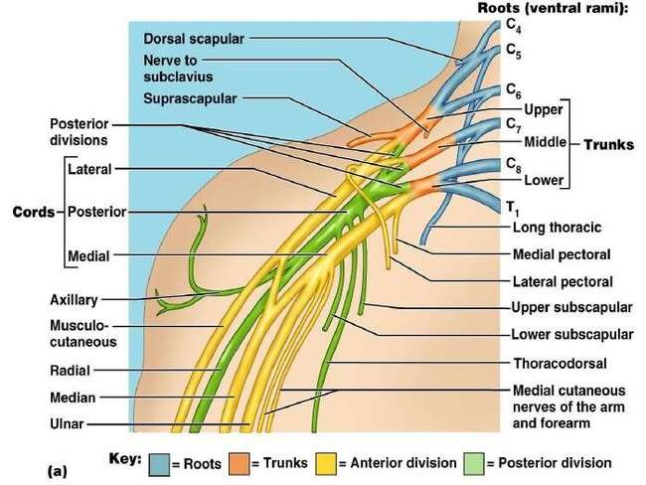
Brachial Plexus
Brachial plexus lies in the neck and axilla
Formed by ventral rami of C₅ – T1 give rise to cords
Gives rise to the axillary, musculocutaneous, median,
radial and ulnar nerves
Figure 14.9d

Slide 5
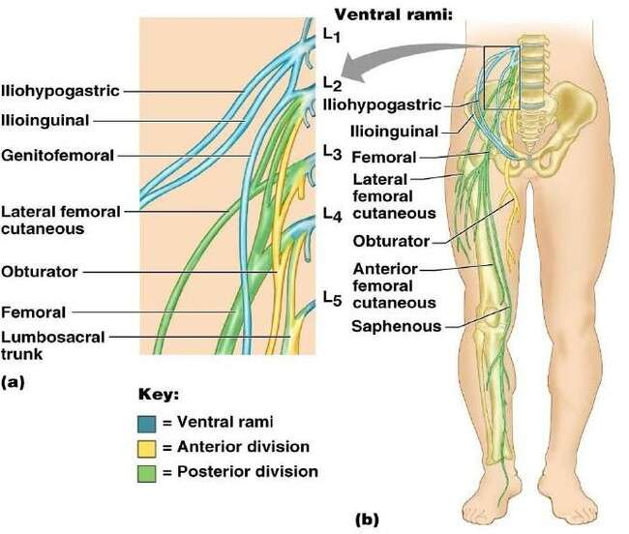
Lumbar Plexus
Arises from L₁– L₄
Smaller branches innervate the posterior abdominal wall and psoas muscle
Its supplies areas of the lower abdomen, inguinal region, hip, and
thigh
Gives rise to the femoral and obturator nerves

Slide 6
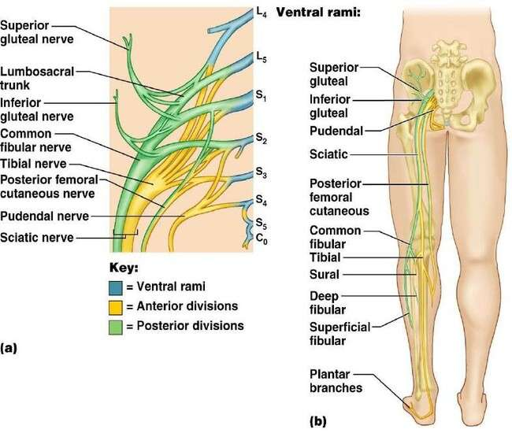
The Sacral Plexus
Arises from spinal nerves L₄–S₄
Often considered with the lumbar plexus referred to as the lumbosacral plexus
It supplies areas of the pelvic floor and muscles around the hip joint
Sciatic nerve – the largest nerve of the sacral plexus is actually two nerves in one sheath
Tibial nerve – innervates most of the posterior lower limb
Common fibular (peroneal) nerve – innervates muscles of the anterolateral leg

Slide 7
Coccygeal plexus
Coccygeal plexus- small plexus formed by parts of the 4th and 5th sacral nerves and the coccygeal nerves
Supplies the area of the coccyx and some parts of the pelvic floor

Slide 8
Dermatome
The area of skin innervated by a single spinal nerve is called a dermatome
Damage to a particular nerve will result in loss of
sensation of in it’s dermatome
There is often overlap, and variations exist between individuals

Slide 9
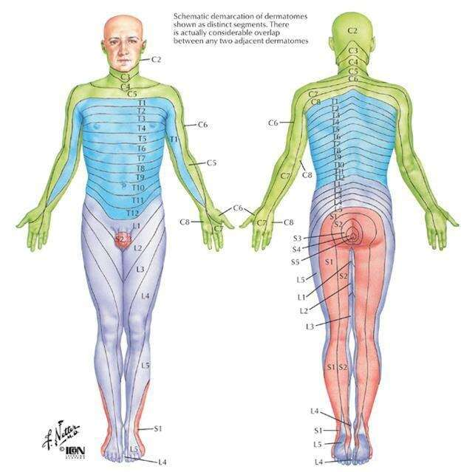
Dermatome

Slide 10
What can go wrong?
Injury to the spinal cord will affect motor and sensory function below the level of injury
C3 or above – unable to breathe without mechanical ventilation
Above T1 – quadriplegia (no use of upper or lower limbs)
Below T1 – paraplegia (no use of lower limbs)

