Slide 1
Nurses Catalyst Fetal Circulation.
https://www.nursescatalyst.com/

Slide 4
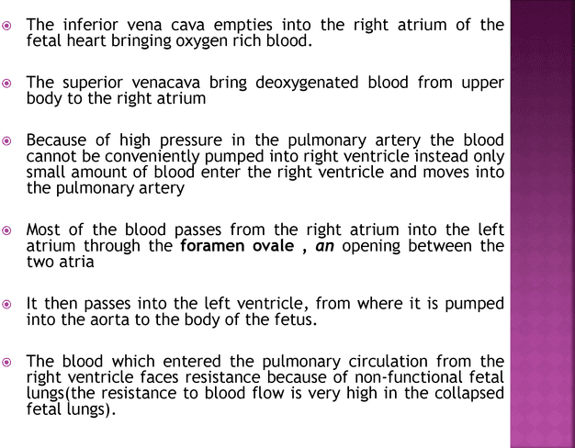

Slide 6
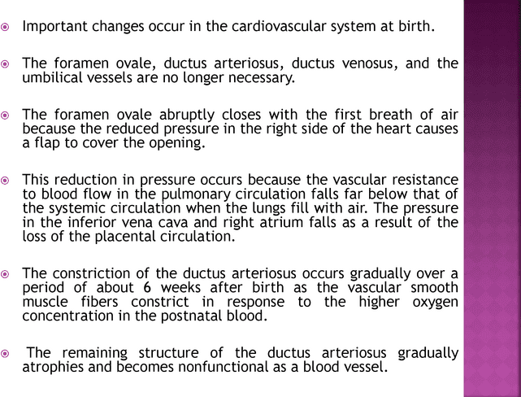

Slide 7
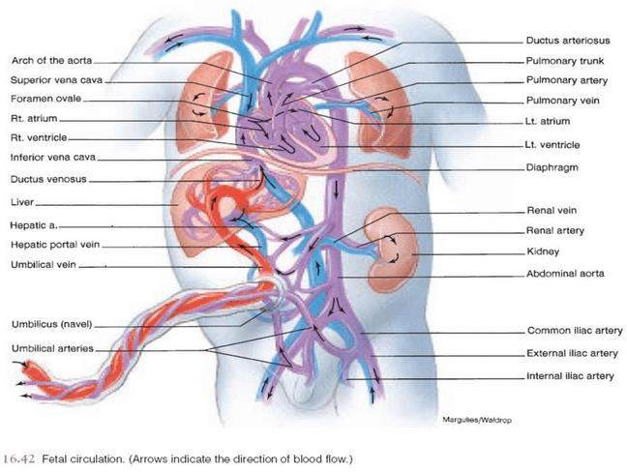

Slide 8
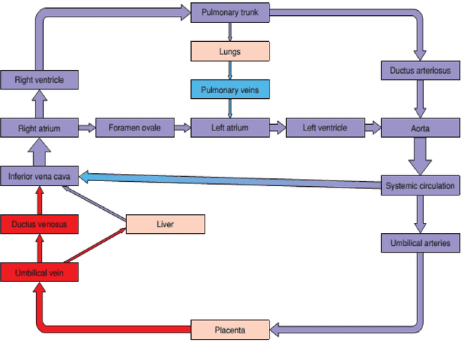

Slide 12
